Slide 1
Internet Control Message Protocol Version 4 (ICMPv4)
TCP/IP Protocol Suite

Slide 2
9.1 INTRODUCTION
The IP protocol has no error-reporting or error-correcting mechanism.
What happens if something goes wrong?
What happens if a router must discard a datagram because it cannot find a router to the final destination, or because the time-to-live field has a zero value?
What happens if the final destination host must discard all fragments of a datagram because it has not received all fragments within a predetermined time limit?
These are examples of situations where an error has occurred and the IP protocol has no built-in mechanism to notify the original host.
TCP/IP Protocol Suite

Slide 3
The IP protocol also lacks a mechanism for host and management queries.
A host sometimes needs to determine if a router or another host is alive.
Sometimes a network manager needs information from another host or router.
TCP/IP Protocol Suite

Slide 4
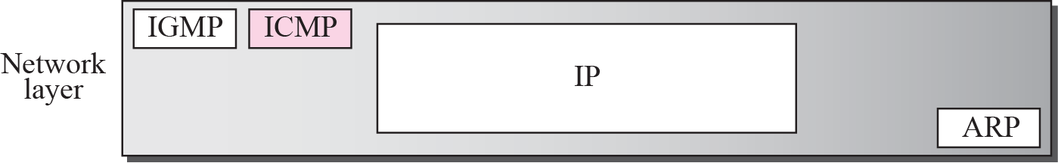
Figure 9.1 Position of ICMP in the network layer
Internet Control Message Protocol (ICMP) has been designed to compensate for the above two deficiencies.
It is a companion to the IP protocol.
Figure 9.1 shows the position of ICMP in relation to IP and other protocols in the network layer.
Figure 9.1 Position of ICMP in the network layer.
TCP/IP Protocol Suite

Slide 5
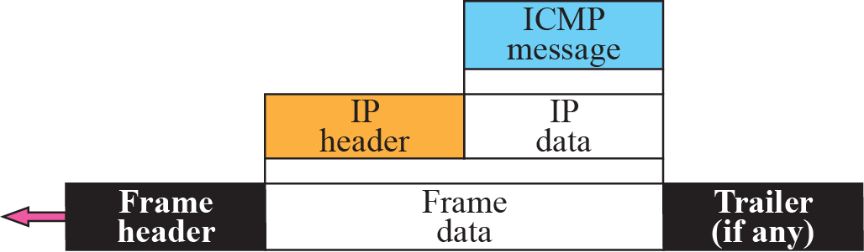
Figure 9.2 ICMP encapsulation
ICMP itself is a network layer protocol.
However, its messages are not passed directly to the data link layer.
Instead, the messages are first encapsulated inside IP datagrams before going to the lower layer.
The value of the protocol field in the IP datagram is 1 to indicate that the IP data is an ICMP message.
Figure 9.2 ICMP encapsulation.
TCP/IP Protocol Suite

Slide 6
9-2 MESSAGES
ICMP messages are divided into two broad categories:
  Error-reporting messages.
  Query messages.
Error-reporting messages : report problems that a router or a host (destination) may encounter when it processes an IP packet.
Query messages : which occur in pairs, help a host or a network manager get specific information from a router or another host.
TCP/IP Protocol Suite

Slide 7
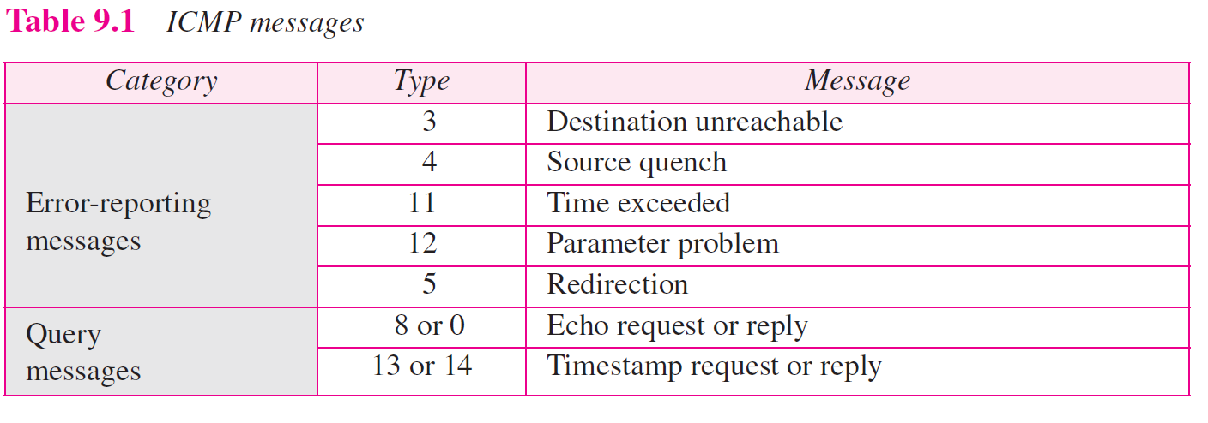
Table 9.1 lists the ICMP messages in each category.
TCP/IP Protocol Suite

Slide 8
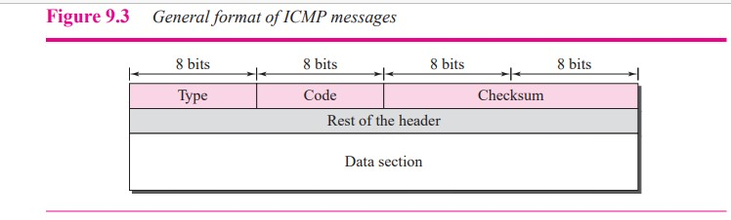
Message Format
An ICMP message has an 8-byte header and a variable-size data section.
Although the general format of the header is different for each message type, the first 4 bytes are common to all.
As Figure 9.3 shows, the first field, ICMP type, defines the type of the message.
The code field specifies the reason for the particular message type.
The last common field is the checksum field.
The rest of the header is specific for each message type.
The data section in error messages carries information for finding the original packet that had the error. In query messages, the data section carries extra information based on the type of the query.
TCP/IP Protocol Suite

Slide 9
Error Reporting Messages
IP, is an unreliable protocol. This means that error checking and error control are not a concern of IP.
ICMP was designed, to compensate for this shortcoming.
ICMP does not correct errors, it simply reports them.
Error correction is left to the higher-level protocols.
Error messages are always sent to the original source because the only information available in the datagram about the route is the source and destination IP addresses.
TCP/IP Protocol Suite

Slide 10
Error Reporting Messages
All error messages contain a data section that includes the IP header of the original datagram plus the first 8 bytes of data in that datagram.
The original datagram header is added to give the information about the datagram itself.
The 8 bytes of data are included because, the first 8 bytes provide information about the port numbers (UDP and TCP) and sequence number (TCP).
This information is needed so the source can inform the protocols (TCP or UDP) about the error.
TCP/IP Protocol Suite

Slide 11
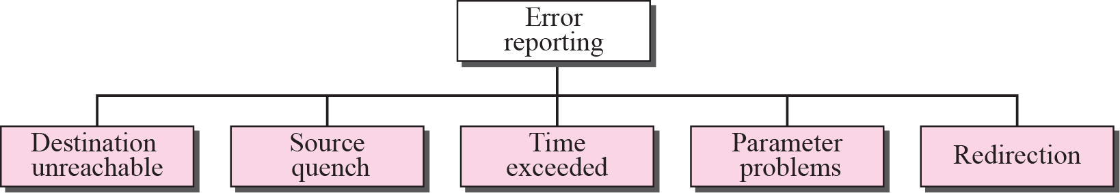
Figure 9.4 Error-reporting messages
TCP/IP Protocol Suite

Slide 12
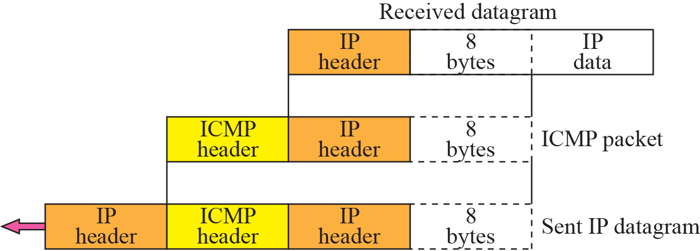
Figure 9.5 Contents of data field for the error message
ICMP forms an error packet, which is then encapsulated in an IP datagram
TCP/IP Protocol Suite

Slide 13
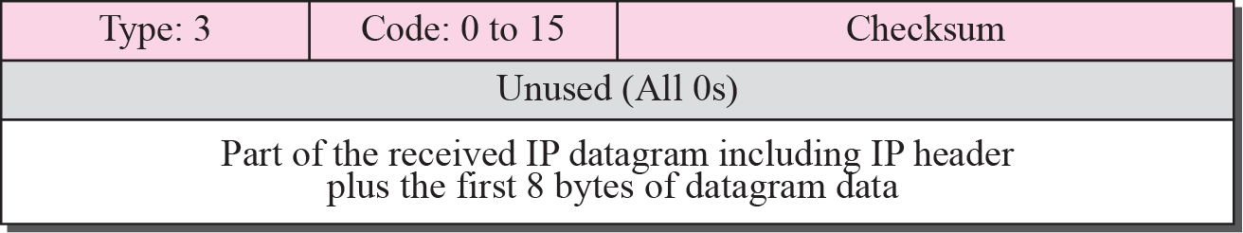
Figure 9.6 Destination-unreachable format
Destination Unreachable
When a router cannot route a datagram or a host cannot deliver a datagram, the datagram is discarded and the router or the host sends a destination-unreachable message back to the source host that initiated the datagram.
Code field for this type specifies the reason for discarding the datagram:
TCP/IP Protocol Suite

Slide 14
Figure 9.6 Destination-unreachable format
Code field for this type specifies the reason for discarding the datagram:
Code 0. The network is unreachable, possibly due to hardware failure.
Code 1. The host is unreachable. This can also be due to hardware failure.
*Code 2. The protocol is unreachable. An IP datagram can carry data belonging to higher-level protocols such as UDP, TCP, and open shortest path first (OSPF). If the destination host receives a datagram that must be delivered, for example, to the TCP protocol, but the TCP protocol is not running at the moment, a code 2 message is sent.
*Code 3. The port is unreachable. The application program (process) that the datagram is destined for is not running at the moment.
Code 4. Fragmentation is required, but the DF (do not fragment) field of the datagram has been set. In other words, the sender of the datagram has specified that the datagram not be fragmented, but routing is impossible without fragmentation.
TCP/IP Protocol Suite

Slide 15
Figure 9.6 Destination-unreachable format
Destination Unreachable
Code 5. Source routing cannot be accomplished. In other words, one or more routers defined in the source routing option cannot be visited.
Code 6. The destination network is unknown. This is different from code 0. In code 0, the router knows that the destination network exists, but it is unreachable at the moment. For code 6, the router has no information about the destination network.
Code 7. The destination host is unknown. This is different from code 1. In code 1, the router knows that the destination host exists, but it is unreachable at the moment. For code 7, the router is unaware of the existence of the destination host.
Code 8. The source host is isolated.
Code 9. Communication with the destination network is administratively prohibited.
Code 10. Communication with the destination host is administratively prohibited.
TCP/IP Protocol Suite

Slide 16
Figure 9.6 Destination-unreachable format
Destination Unreachable
Code 11. The network is unreachable for the specified type of service. This is different from code 0. Here the router can route the datagram if the source had requested an available type of service.
Code 12. The host is unreachable for the specified type of service. This is different from code 1. Here the router can route the datagram if the source had requested an available type of service.
Code 13. The host is unreachable because the administrator has put a filter on it.
Code 14. The host is unreachable because the host precedence is violated. The message is sent by a router to indicate that the requested precedence is not permitted for the destination.
Code 15. The host is unreachable because its precedence was cut off. This message is generated when the network operators have imposed a minimum level of precedence for the operation of the network, but the datagram was sent with a precedence below this level
TCP/IP Protocol Suite

Slide 17
Figure 9.6 Destination-unreachable format
Destination Unreachable
Destination-unreachable messages can be created either by a router or the destination host.
Code 2 and code 3 messages can only be created by the destination host.
The messages of the remaining codes can only be created by routers.
Even if a router does not report a destination-unreachable message, it does not necessarily mean that the datagram has been delivered.
TCP/IP Protocol Suite

Slide 18
Figure 9.7 Source-quench format
Source Quench
The IP protocol is a connectionless protocol.
The source-quench message in ICMP was designed to add a kind of flow control and congestion control to the IP.
When a router or host discards a datagram due to congestion, it sends a source-quench message to the sender of the datagram.
This message has two purposes.
First, it informs the source that the datagram has been discarded.
Second, it warns the source that there is congestion somewhere in the path and that the source should slow down (quench) the sending process.
TCP/IP Protocol Suite

Slide 19
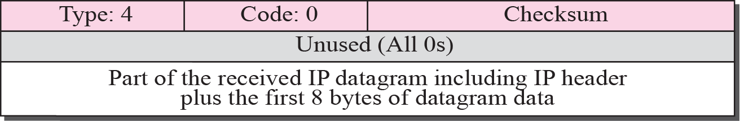
Figure 9.7 Source-quench format
Source Quench
TCP/IP Protocol Suite

Slide 20
Figure 9.7 Source-quench format
Source Quench
First, the router or destination host that has experienced the congestion sends one source-quench message for each discarded datagram to the source host.
Second, there is no mechanism to tell the source that the congestion has been relieved and the source can resume sending datagrams at its previous rate. The source continues to lower the rate until no more source-quench messages are received.
Third, the congestion can be created either by a one-to-one or many-to-one communication.
In a one-to-one communication, source-quench messages can be helpful. They tell the source to slow down.
In a many-to-one communication, many sources create datagrams that must be handled by a router or the destination host. In this case, each source can be sending datagrams at different speeds, some of them at a low rate, others at a high rate. Here, the source-quench message may not be very useful. The router or the destination host has no clue which source is responsible for the congestion. It may drop a datagram from a very slow source instead of dropping the datagram from the source that has actually created the congestion.
TCP/IP Protocol Suite

Slide 21

Note
A source-quench message informs the source that a datagram has been discarded due to congestion in
a router or the destination host.
The source must slow down the sending of datagrams until the congestion is relieved.
TCP/IP Protocol Suite

Slide 22
Note
One source-quench message is sent for each datagram that is discarded due
to congestion.
TCP/IP Protocol Suite

Slide 23
Figure 9.8 Time-exceeded message format
Time Exceeded
The time-exceeded message is generated in two cases:
First, routers use routing tables to find the next hop (next router) that must receive the packet. If there are errors in one or more routing tables, a packet can travel in a loop or a cycle, going from one router to the next or visiting a series of routers endlessly. Each datagram contains a field called time to live that controls this situation. When a datagram visits a router, the value of this field is decremented by 1. When the time-to-live value reaches 0, after decrementing, the router discards the datagram.
However, when the datagram is discarded, a time-exceeded message must be sent by the router to the original source.
Second, a time-exceeded message is also generated when all fragments that make up a message do not arrive at the destination host within a certain time limit. When the first fragment arrives, the destination host starts a timer. If all the fragments have not arrived when the time expires, the destination discards all the fragments and sends a time-exceeded message to the original sender.
TCP/IP Protocol Suite

Slide 24
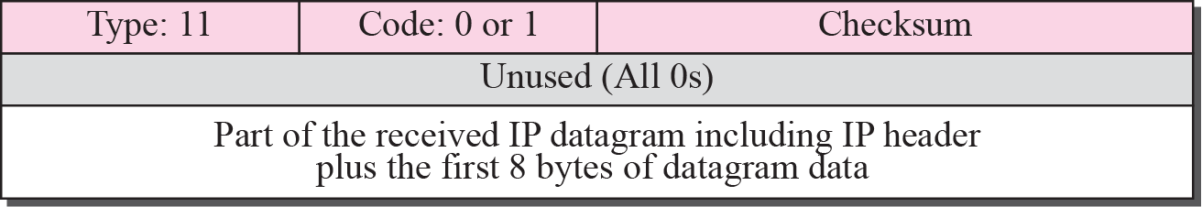
Figure 9.8 Time-exceeded message format
Time Exceeded
Code 0 : Datagram is discarded by the router due to a time-to-live field value of zero.
Code 1 : when arrived fragments of a datagram are discarded because some fragments have not arrived within the time limit.
TCP/IP Protocol Suite

Slide 25
Figure 9.9 Parameter-problem message format
Parameter Problem
Any ambiguity in the header part of a datagram can create serious problems as the datagram travels through the Internet.
If a router or the destination host discovers an ambiguous or missing value in any field of the datagram, it discards the datagram and sends a parameter-problem message back to the source.
TCP/IP Protocol Suite

Slide 26
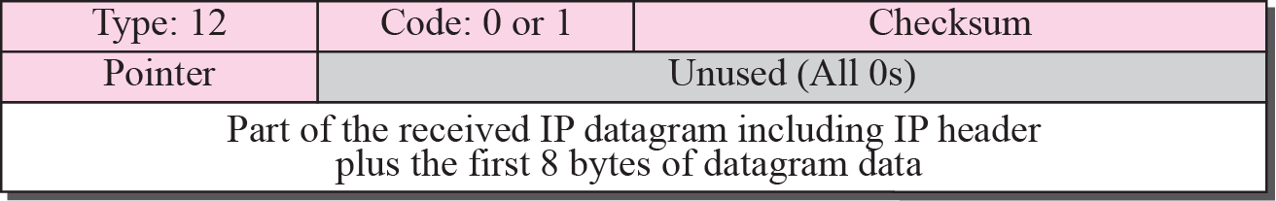
Figure 9.9 Parameter-problem message format
Parameter Problem
Code 0. There is an error or ambiguity in one of the header fields.
In this case, the value in the pointer field points to the byte with the problem. For example, if the value is zero, then the first byte is not a valid field.
Code 1. The required part of an option is missing. In this case, the pointer is not used.
TCP/IP Protocol Suite

Slide 27
Figure 9.10 Redirection concept
Redirection
Both routers and hosts have a routing table to find the address of the next router.
Routers take part in the routing update process and are supposed to be updated constantly.
Hosts do not take part in the routing update process because there are many more hosts in an internet than routers.
When a host comes up, its routing table has a limited number of entries. It usually knows only the IP address of one router, the default router.
For this reason, the host may send a datagram, which is destined for another network, to the wrong router. In this case, the router that receives the datagram will forward the datagram to the correct router. However, to update the routing table of the host, it sends a redirection message to the host.
TCP/IP Protocol Suite

Slide 28
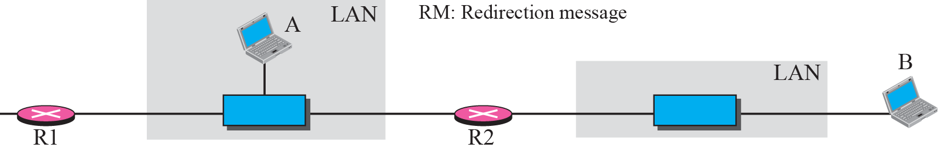
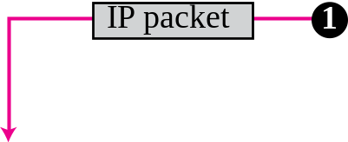

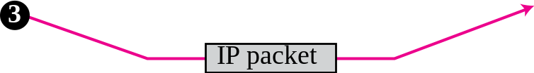
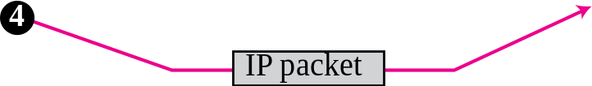
Figure 9.10 Redirection concept
This concept of redirection is shown in Figure 9.10.
Host A wants to send a datagram to host B. Router R2 is obviously the most efficient routing choice, but host A did not choose router R2.
The datagram goes to R1 instead. R1, after consulting its table, finds that the packet should have gone to R2.
It sends the packet to R2 and, at the same time, sends a redirection message to host A.
Host A’s routing table can now be updated
TCP/IP Protocol Suite

Slide 29
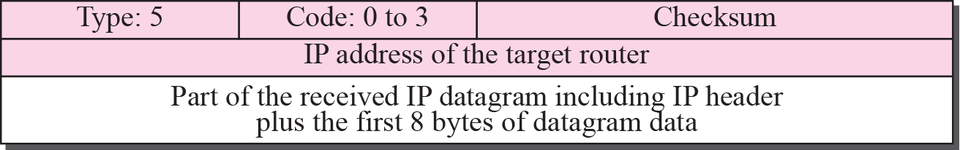
Figure 9.11 Redirection message format
The IP address of the appropriate target is given in the second row.
Although the redirection message is considered an error-reporting message, it is different from other error messages. The router does not discard the datagram in this case; it is sent to the appropriate router.
Code 0. Redirection for a network-specific route.
Code 1. Redirection for a host-specific route.
Code 2. Redirection for a network-specific route based on a specified type of service. Code 3. Redirection for a host-specific route based on a specified type of service.
TCP/IP Protocol Suite

Slide 30
Query Messages
A group of five different pairs of messages have been designed for this purpose, but three of these pairs are deprecated today.
Only two pairs are used today:
  echo request and replay
  timestamp request and replay.
In this type of ICMP message, a node sends a message that is answered in a specific format by the destination node.
TCP/IP Protocol Suite

Slide 31
Echo Request and Reply
The echo-request and echo-reply messages are designed for diagnostic purposes.
Network managers and users utilize this pair of messages to identify network problems.
The combination of echo-request and echo-reply messages determines whether two systems (hosts or routers) can communicate with each other.
A host or router can send an echo-request message to another host or router.
The host or router that receives an echo-request message creates an echo-reply message and returns it to the original sender
TCP/IP Protocol Suite

Slide 32
Echo Request and Reply
The echo-request and echo-reply messages can be used to determine if there is communication at the IP level.
Because ICMP messages are encapsulated in IP datagrams, the receipt of an echo-reply message by the machine that sent the echo request is proof that the IP protocols in the sender and receiver are communicating with each other using the IP datagram.
Also, it is proof that the intermediate routers are receiving, processing, and forwarding IP datagrams.
The echo-request and echo-reply messages can also be used by a host to see if another host is reachable.
At the user level, this is done by invoking the packet Internet groper (ping) command.
TCP/IP Protocol Suite

Slide 33
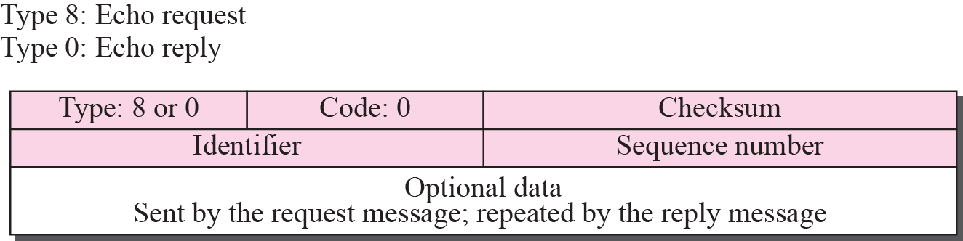
Figure 9.12 Echo-request and echo-reply message
Echo request, together with echo reply, can determine whether or not a node is functioning properly.
The optional data field contains a message that must be repeated exactly by the responding node in its echo-reply message.
The identifier and sequence number fields are not formally defined by the protocol and can be used arbitrarily by the sender. The identifier is often the same as the process ID.
TCP/IP Protocol Suite

Slide 34
Figure 9.13 Timestamp-request and timestamp-reply message format
Timestamp Request and Reply
Two machines (hosts or routers) can use the timestamp-request and timestamp-reply messages to determine the round-trip time needed for an IP datagram to travel between them.
It can also be used to synchronize the clocks in two machines.
TCP/IP Protocol Suite

Slide 35
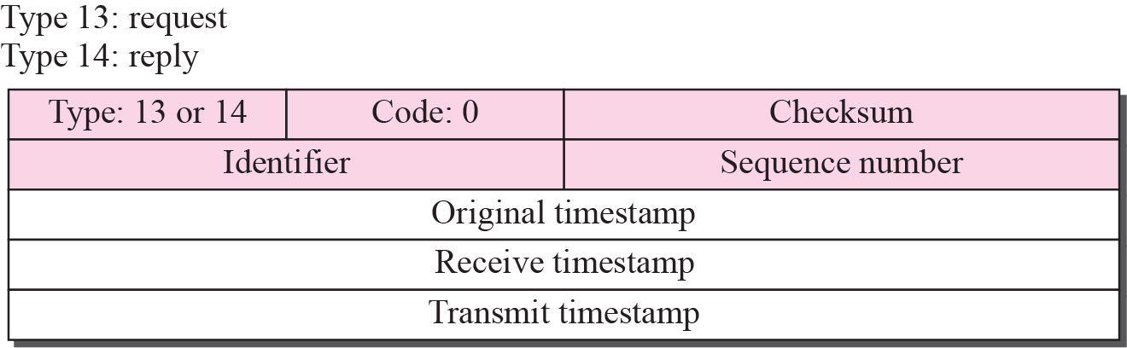
Figure 9.13 Timestamp-request and timestamp-reply message format
Three timestamp fields are each 32 bits long.
The source creates a timestamp-request message.
The source fills the original timestamp field with the clock at departure time. The other two timestamp fields are filled with zeros.
TCP/IP Protocol Suite

Slide 36
Figure 9.13 Timestamp-request and timestamp-reply message format
The destination creates the timestamp-reply message.
The destination copies the original timestamp value from the request message into the same field in its reply message.
It then fills the receive timestamp field with the time the request was received.
Finally, it fills the transmit timestamp field with the time the reply message departs.
TCP/IP Protocol Suite

Slide 37
Figure 9.13 Timestamp-request and timestamp-reply message format
The timestamp-request and timestamp-reply messages can be used to compute the one-way or round-trip time required for a datagram to go from a source to a destination and then back again. The formulas are
sending time = receive timestamp − original timestamp
receiving time = returned time − transmit timestamp
round-trip time = sending time + receiving time
TCP/IP Protocol Suite

Slide 38
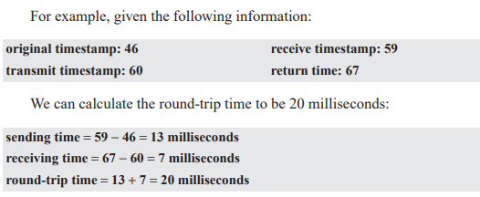
Figure 9.13 Timestamp-request and timestamp-reply message format
Sending and receiving time calculations are accurate only if the two clocks in the source and destination machines are synchronized.
However, the round-trip calculation is correct even if the two clocks are not synchronized because each clock contributes twice to the round-trip calculation, thus canceling any difference in synchronization.
TCP/IP Protocol Suite

Slide 39
Figure 9.13 Timestamp-request and timestamp-reply message format
Given the actual one-way time, the timestamp-request and timestamp-reply messages can also be used to synchronize the clocks in two machines using the following formula:
The one-way time duration can be obtained either by dividing the round-trip time duration by two.
For example, we can tell that the two clocks in the previous example are 3 milliseconds out of synchronization because
Time difference = 59 − (46 + 10) = 3
TCP/IP Protocol Suite

Slide 40
Important points about ICMP error messages:
No ICMP error message will be generated in response to a datagram carrying an ICMP error message.
No ICMP error message will be generated for a fragmented datagram that is not the first fragment.
No ICMP error message will be generated for a datagram having a multicast address.
No ICMP error message will be generated for a datagram having a special address such as 127.0.0.0 or 0.0.0.0.
TCP/IP Protocol Suite

Slide 41
Deprecated Messages
Three pairs of messages are declared obsolete by Internet Engineering Task Force (IETF):
Information request and replay messages are not used today because their duties are done by Address Resolution Protocol (ARP).
Address mask request and reply messages are not used today because their duties are done by Dynamic Host Configuration Protocol (DHCP).
Router solicitation and advertisment messages are not used today because their duties are done by Dynamic Host Configuration Protocol (DHCP).
TCP/IP Protocol Suite

Slide 42
9-3 DEBUGGING TOOLS
There are several tools that can be used in the Internet for debugging.
We can find if a host or router is alive and running.
We can trace the route of a packet.
two tools that use ICMP for debugging: ping and traceroute.
TCP/IP Protocol Suite

Slide 43
Example 9.1
END
TCP/IP Protocol Suite
tracert Route type

Slide 44
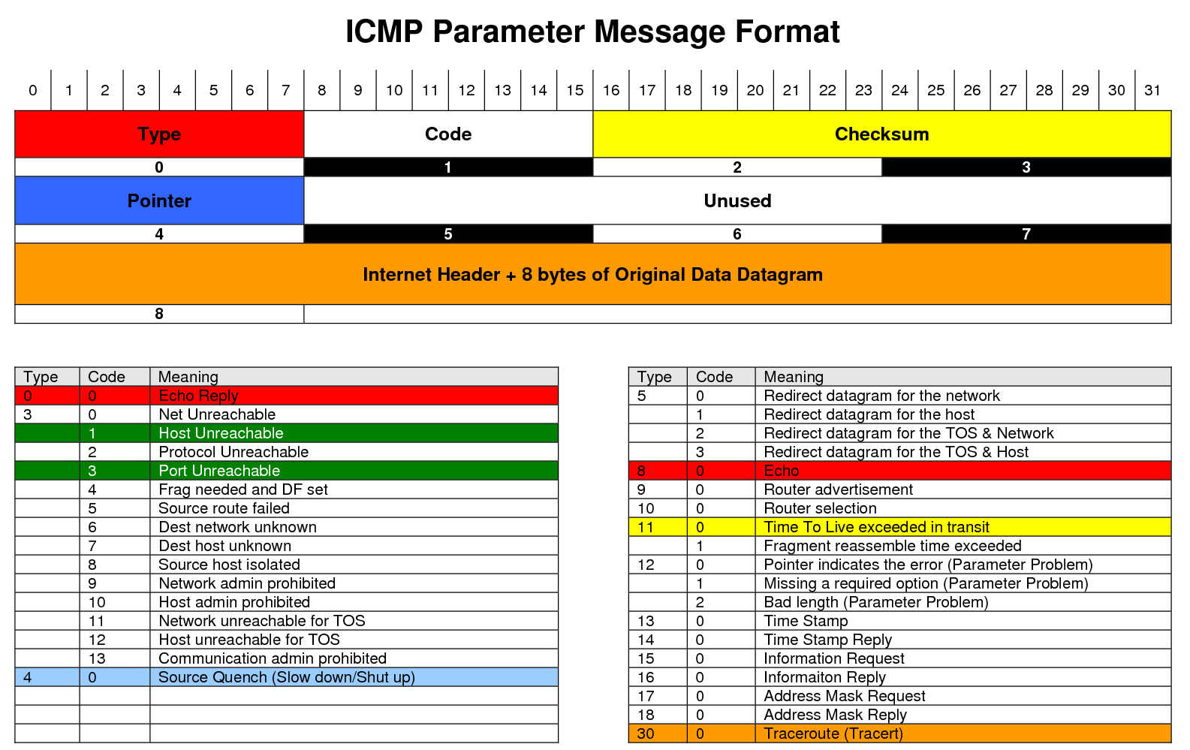
TCP/IP Protocol Suite

